Slide 1


Slide 2
What is Devise
Flexible authentication solution for Rails with Warden by Plataformatec
A gem I’ve used for a long long time
A gem that still mystify us (don’t they all)

Slide 3
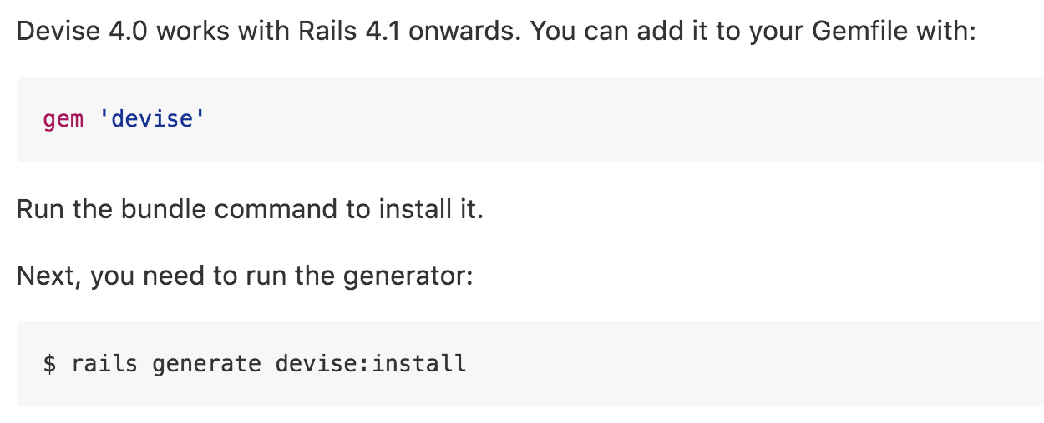

Slide 4
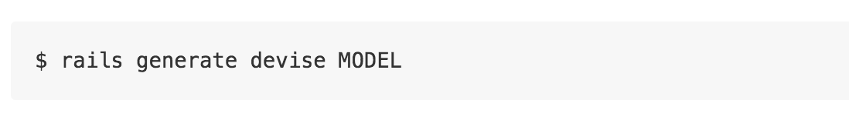
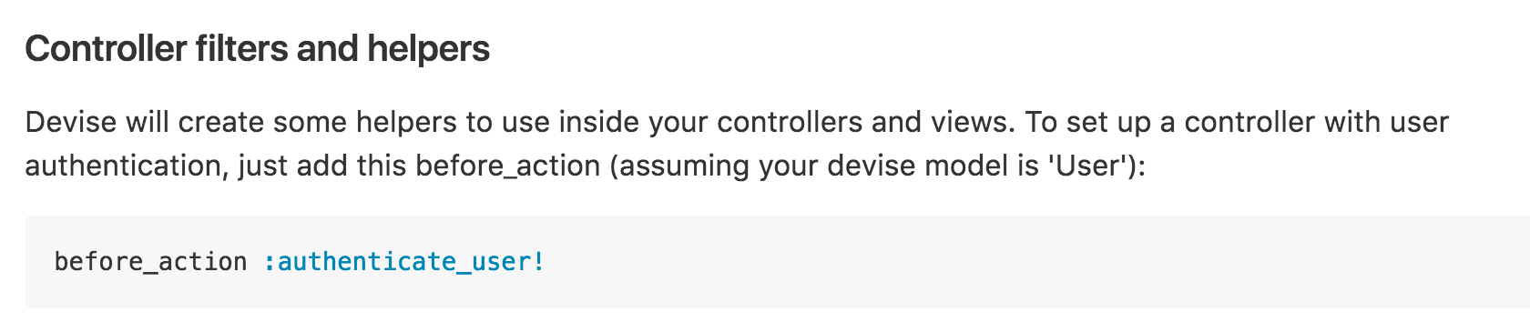

Slide 5
Magic much?

Slide 6
Purpose
Learn how to dig deep
Learn how gems are built
Pick up some tips & tricks

Slide 7
Study Area
Basic building blocks
Generators
Routing
Modules

Slide 8
Basic Building Blocks
warden - Rack based Auth framework
orm_adapter - For DB connections
bcrypt - For password encryption
railties - For Rails generator & stuffs
responders - respond_with + respond_to helpers

Slide 9
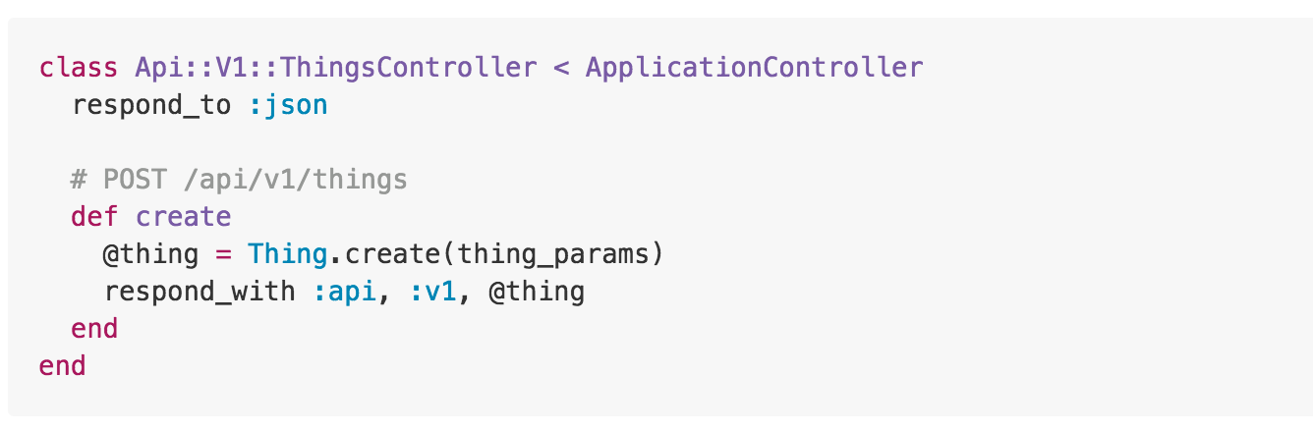
Responders
respond_with + respond_to Controller helpers
separated from Rails after 4.2.0

Slide 10
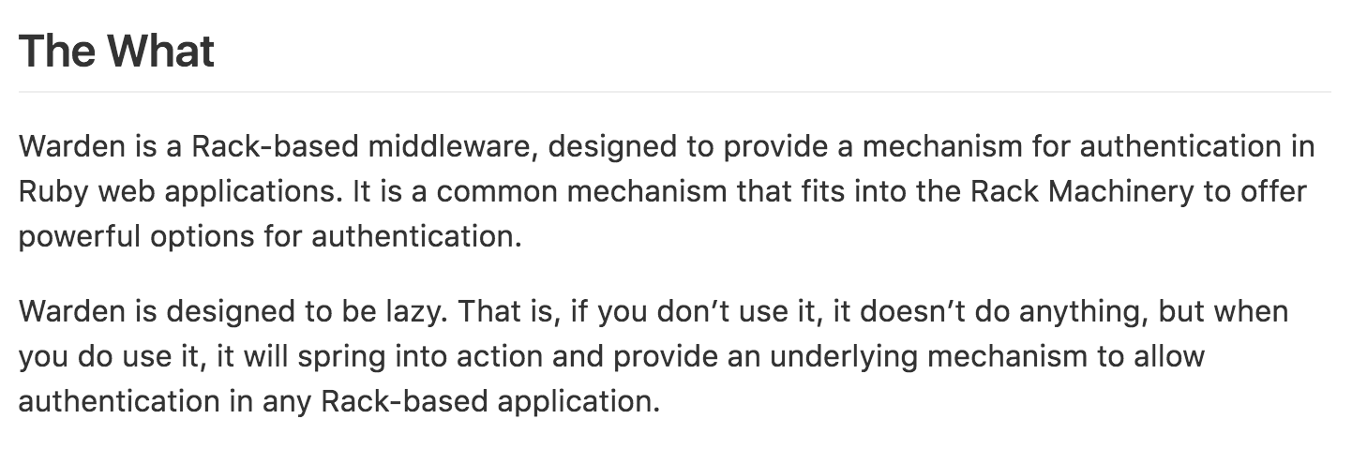
Warden

Slide 11
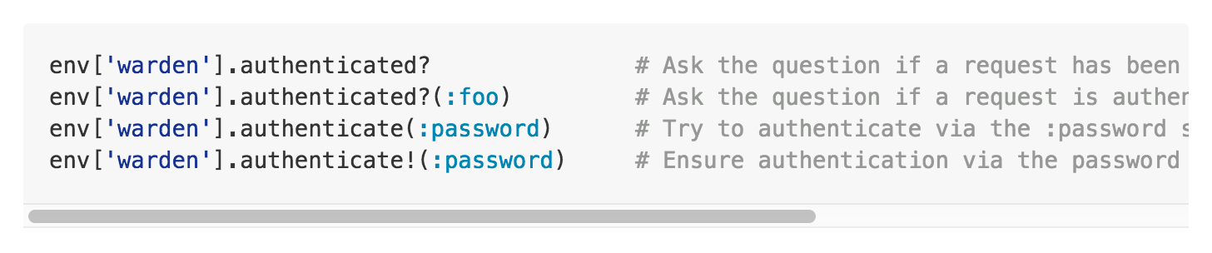
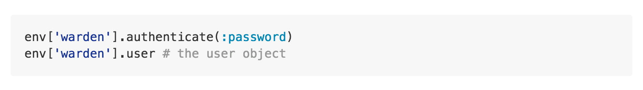
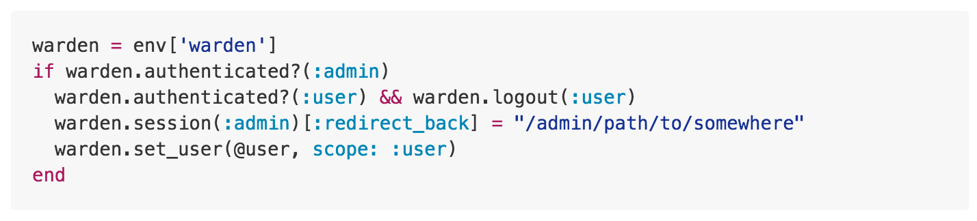

Slide 12
Demo

Slide 13
Generators
lib/generators/active_record
lib/generators/devise
lib/generators/mongoid
lib/generators/templates

Slide 14
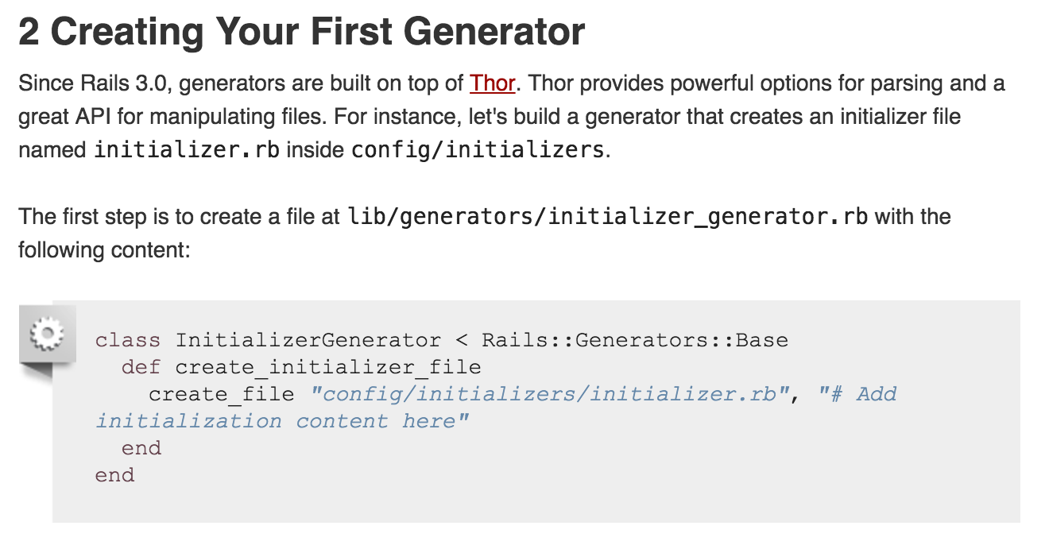


Slide 15
Devise Routes
lib/devise/rails/routes.rb
def devise_for

Slide 16
Look at Code

Slide 17
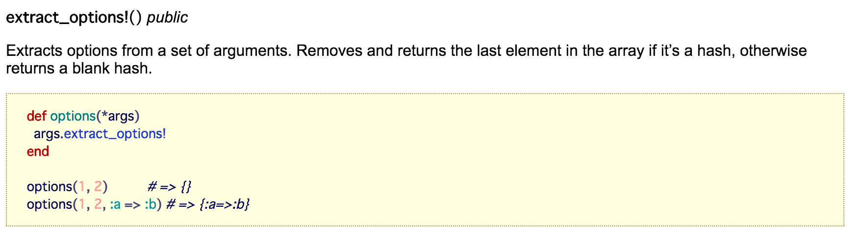
Array#extract_options!

Slide 18
Route Contraints
http://api.rubyonrails.org/classes/ActionDispatch/Routing/Mapper/Scoping.html#method-i-constraints
devise_scope

Slide 19
Devise::Mapping
lib/devise/mapping.rb
Stores all information about a certain mapping (devise_for object)

Slide 20
Modules
Rememberable
Trackable
Timetable
Validatable
Lockable
Database Authenticable
Omniauthable
Confirmable
Recoverable
Registrable

Slide 21
Look at Code

Slide 22
Modules
lib/devise/models.rb
def devise(*modules)

Slide 23
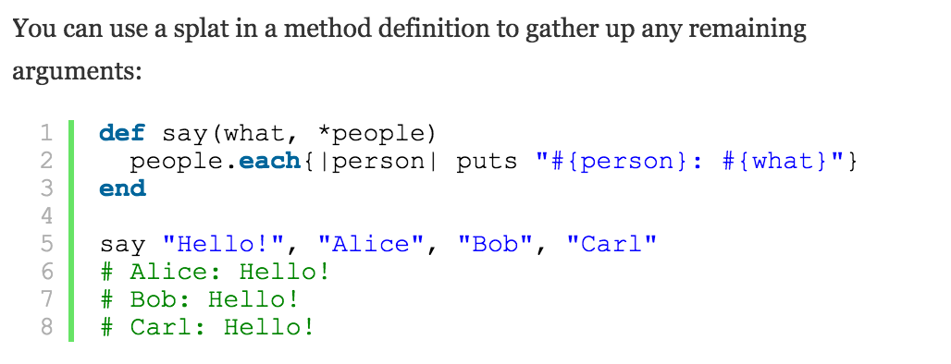
Splat Operator (*)

Slide 24
Q&A

